Slide 1
LSTM

Slide 2
Long Short Term Memory (LSTM)
Hochreiter & Schmidhuber (1997) solved the problem of getting an RNN to remember things for a long time (like hundreds of time steps).
They designed a memory cell using logistic and linear units with multiplicative interactions.
Information gets into the cell whenever its “write” gate is on.
The information stays in the cell so long as its “keep”/ “forget” gate is on.
Information can be read from the cell by turning on its “read” gate.

Slide 3
Basic LSTM

Slide 4
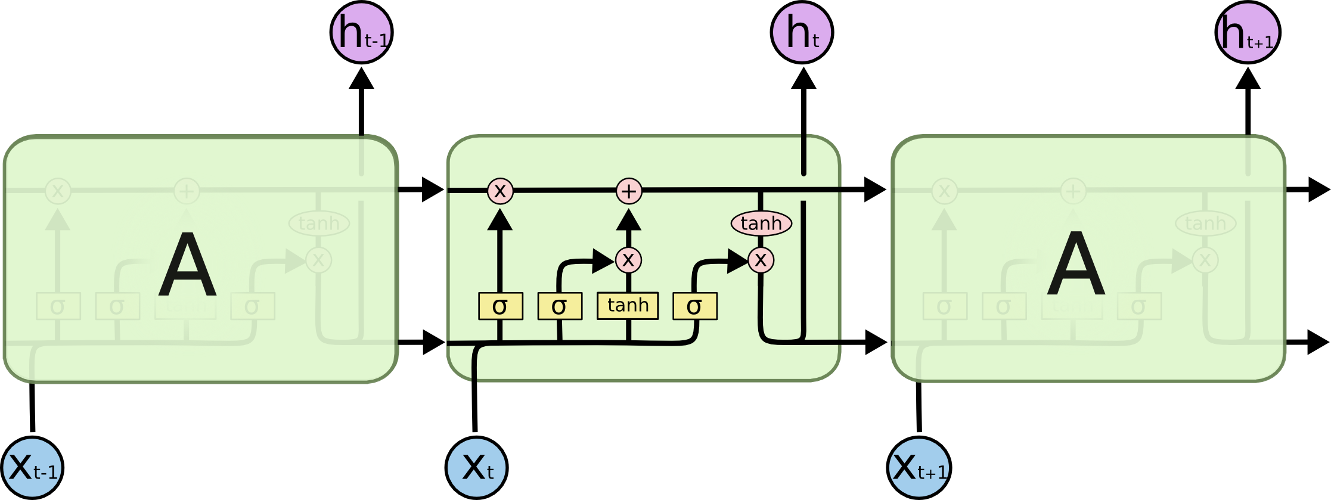
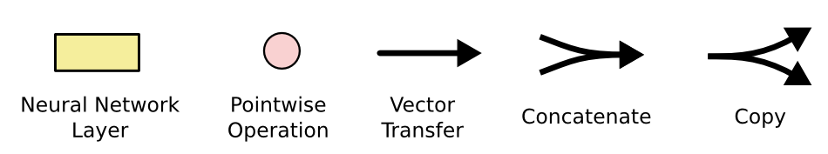
LSTM Network Architecture

Slide 5
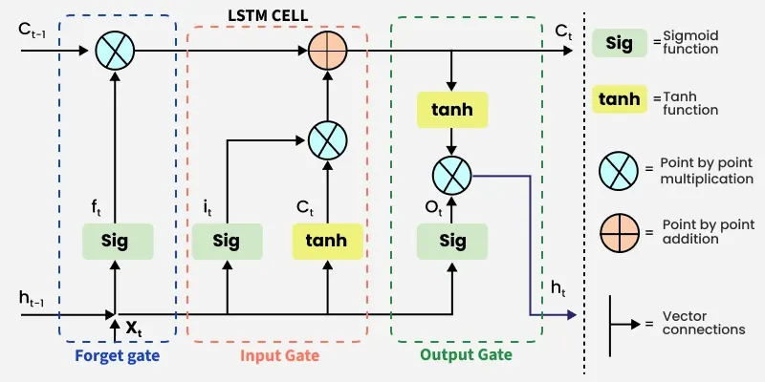
LSTM Network

Slide 6
Implementing a memory cell in a neural network
keep gate
To preserve information for a long time in the activities of an RNN, we use a circuit that implements an analog memory cell.
  A linear unit that has a self-link with a weight of 1 will maintain its state.
  Information is stored in the cell by activating its write gate.
  Information is retrieved by activating the read gate.
  We can backpropagate through this circuit because logistics are have nice derivatives.
1.73
write gate
read gate
input from rest of RNN
output to rest of RNN

Slide 8
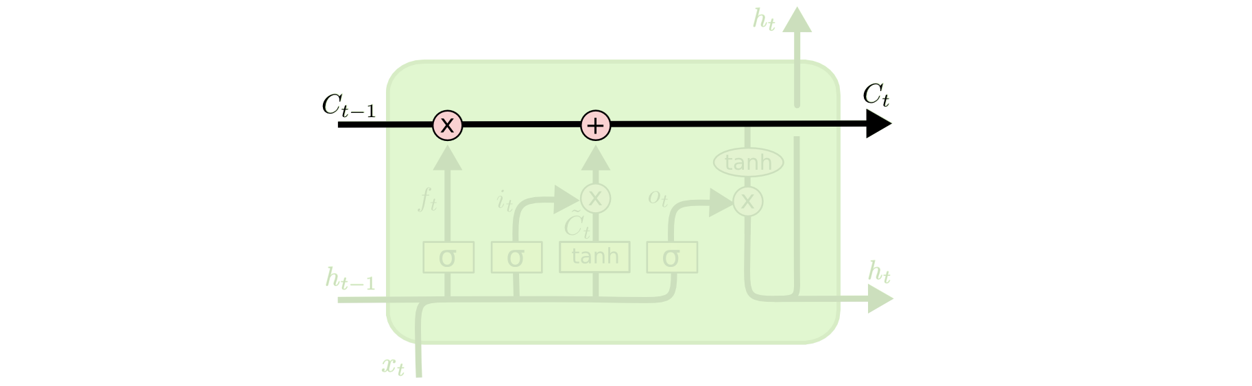
Cell State
Maintains a vector C_{t} that is the same dimensionality as the hidden state, h_{t}
Information can be added or deleted from this state vector via the forget and input gates.

Slide 9
Cell State Example
Want to remember person & number of a subject noun so that it can be checked to agree with the person & number of verb when it is eventually encountered.
Forget gate will remove existing information of a prior subject when a new one is encountered.
Input gate "adds" in the information for the new subject.

Slide 10
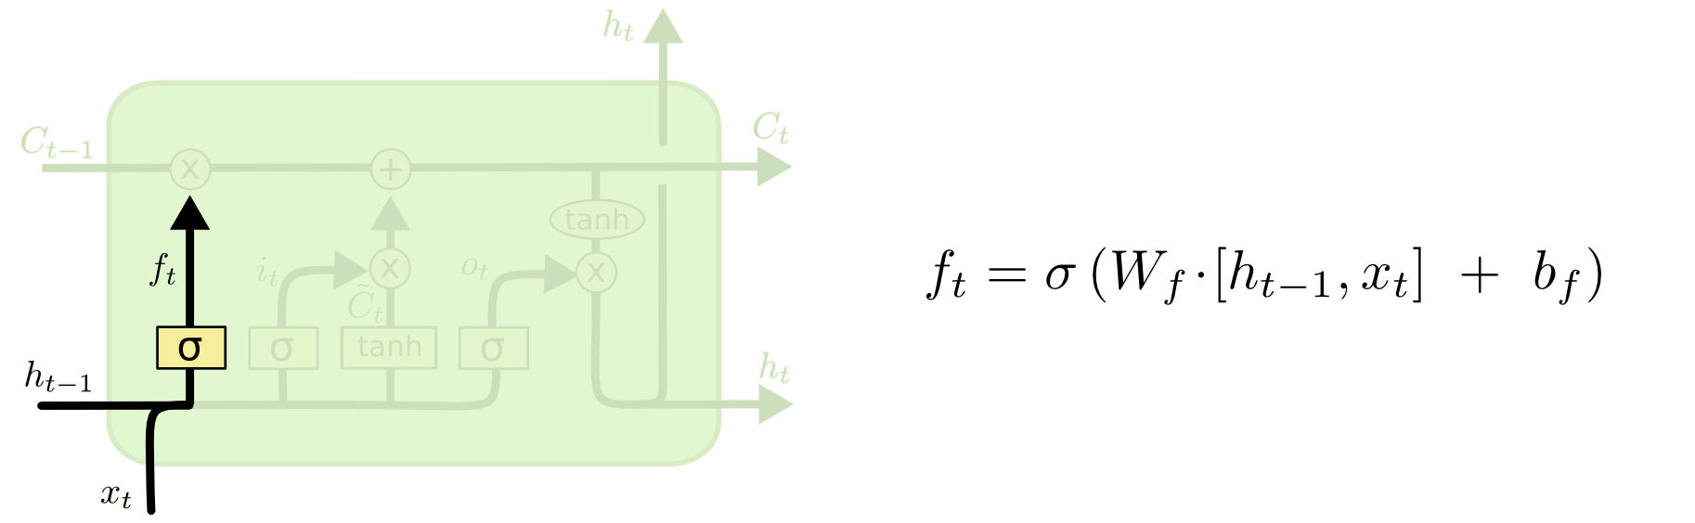
Forget Gate
Forget gate computes a 0-1 value using a logistic sigmoid output function from the input, x_{t}, and the current hidden state, h_{t}:
Multiplicatively combined with cell state, "forgetting" information where the gate outputs something close to 0.

Slide 11
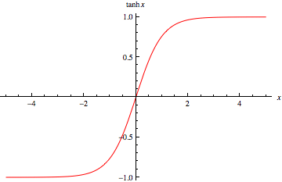
Hyperbolic Tangent Units
Tanh can be used as an alternative nonlinear function to the sigmoid logistic (0-1) output function.
Used to produce thresholded output between –1 and 1.

Slide 12
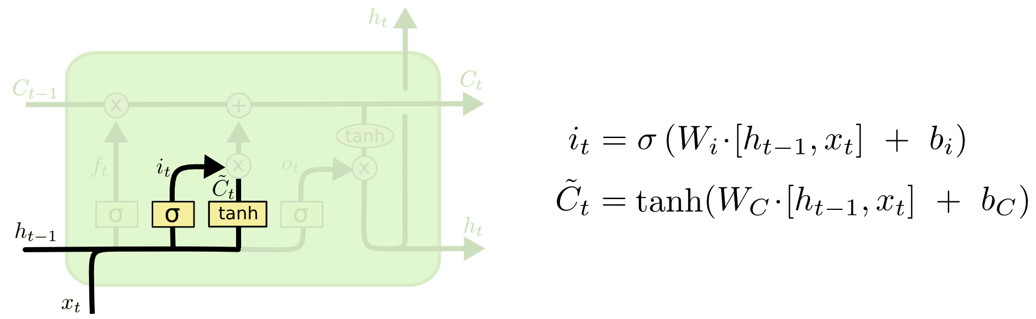
Input Gate
First, determine which entries in the cell state to update by computing 0-1 sigmoid output.
Then determine what amount to add/subtract from these entries by computing a tanh output (valued –1 to 1) function of the input and hidden state.

Slide 13
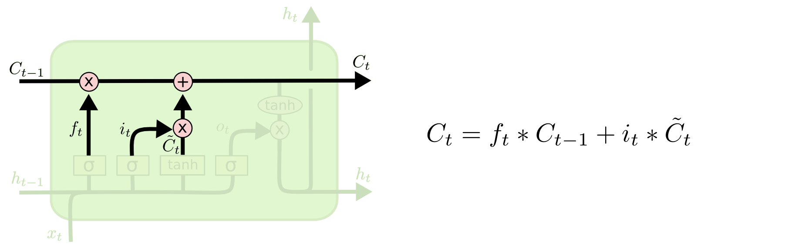
Updating the Cell State/ current state
Cell state is updated by using component-wise vector multiply to "forget" and vector addition to "input" new information.

Slide 14
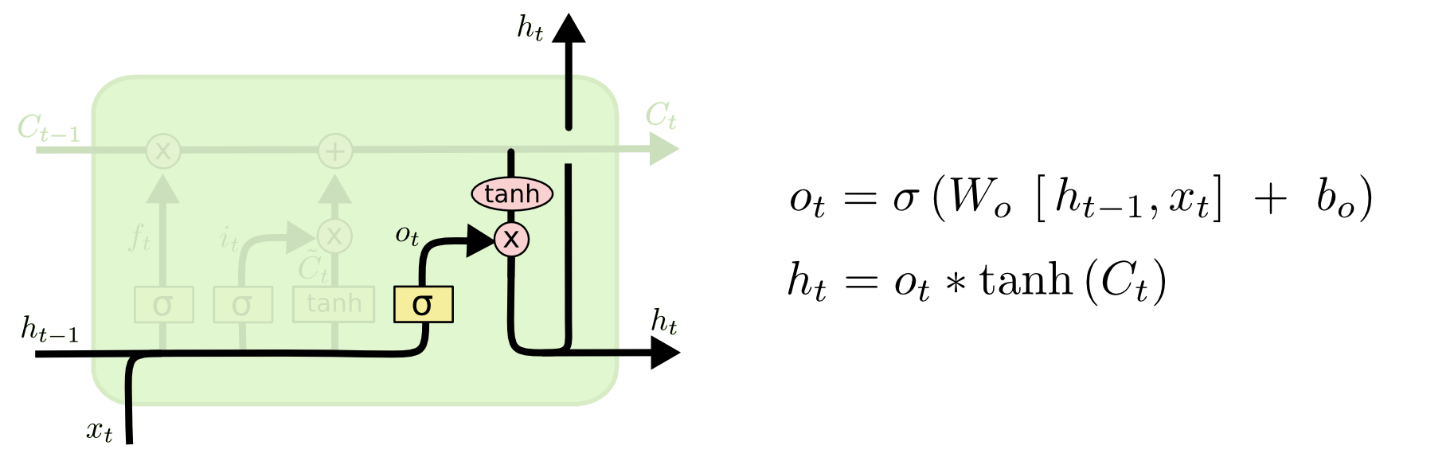
Output Gate
Hidden state is updated based on a "filtered" version of the cell state, scaled to –1 to 1 using tanh.
Output gate computes a sigmoid function of the input and current hidden state to determine which elements of the cell state to "output".

Slide 15
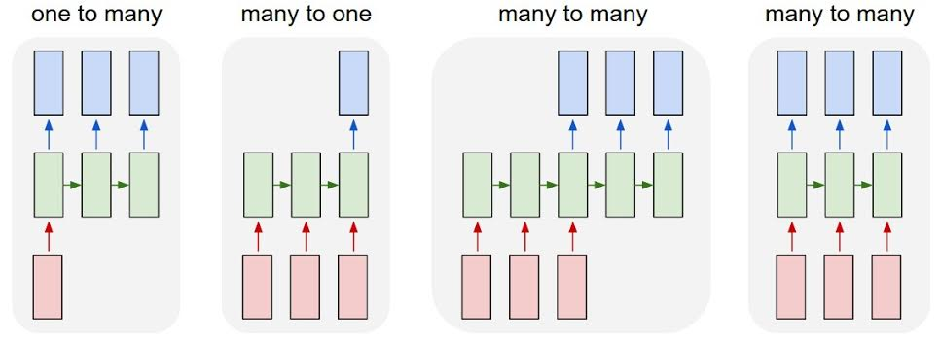
Summary of LSTM Application Architectures
Image Captioning
Video Activity Recognition
Text Classification
Video Captioning
Machine Translation
POS Tagging
Language Modeling

Slide 16
Successful Applications of LSTMs
Speech recognition: Language and acoustic modeling
Sequence labeling
  POS Tagging https://www.aclweb.org/aclwiki/index.php?title=POS_Tagging_(State_of_the_art)
  NER
  Phrase Chunking
Neural syntactic and semantic parsing
Image captioning: CNN output vector to sequence
Sequence to Sequence
  Machine Translation (Sustkever, Vinyals, & Le, 2014)
  Video Captioning (input sequence of CNN frame outputs)

Slide 17


Bi-directional LSTM (Bi-LSTM)
Separate LSTMs process sequence forward and backward and hidden layers at each time step are concatenated to form the cell output.

Slide 18
The problem with LSTMs/RNNs
When sentences are too long LSTMs still don’t do too well.
The reason for that is that the probability of keeping the context from a word that is far away from the current word being processed decreases exponentially with the distance from it.
When sentences are long, the model often forgets the content of distant positions in the sequence. Another problem with RNNs, and LSTMs, is that it’s hard to parallelize the work for processing sentences, since you are have to process word by word. Not only that but there is no model of long and short range dependencies.
Three Problems
  Sequential computation inhibits parallelization
  No explicit modeling of long and short range dependencies
  “Distance” between positions is linear

Slide 19
Attention
To solve some of these problems, researchers created a technique for paying attention to specific words.
Human nature: When translating a sentence, I pay special attention to the word I’m presently translating. When I’m transcribing an audio recording, I listen carefully to the segment I’m actively writing down. And if you ask me to describe the room I’m sitting in, I’ll glance around at the objects I’m describing as I do so.
Neural networks can achieve this same behavior using attention, focusing on part of a subset of the information they are given. For example, an RNN can attend over the output of another RNN. At every time step, it focuses on different positions in the other RNN.
To solve these problems, Attention is a technique that is used in a neural network. For RNNs, instead of only encoding the whole sentence in a hidden state, each word has a corresponding hidden state that is passed all the way to the decoding stage. Then, the hidden states are used at each step of the RNN to decode.

Slide 20
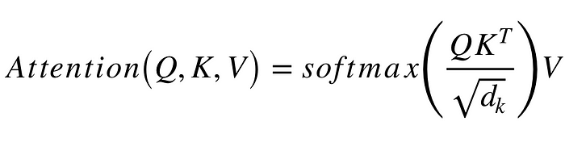
Q is a matrix that contains the query (vector representation of one word in the sequence), K are all the keys (vector representations of all the words in the sequence) and V are the values, which are again the vector representations of all the words in the sequence. For the encoder and decoder, multi-head attention modules, V consists of the same word sequence than Q. However, for the attention module that is taking into account the encoder and the decoder sequences, V is different from the sequence represented by Q.

